Slide 1
ValidateLabs
Validation Processor
Dr Dan Lane & Borislav Lazarov
Revolutionising Assay Translation

Slide 2
Meet Roberta (Bobby)
Scientist in a clinical lab
Working tirelessly to deliver patient diagnostics

Slide 3
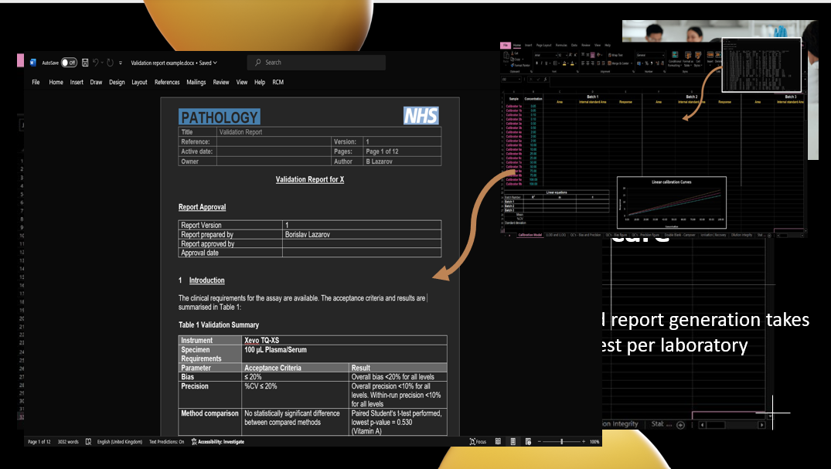
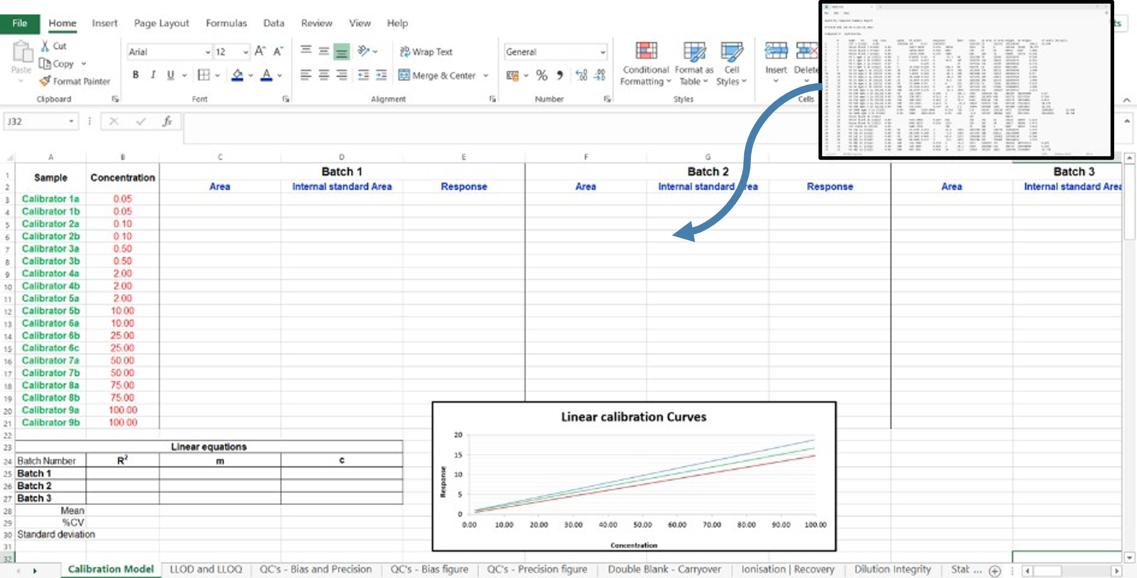
THE PROBLEM
Validation is impacting patient care
Validation must be done to prove tests work as intended
Data processing and report generation takes months per test per laboratory
Notes:
Time, costs, patient impact, under using mass spec, report generation, completely manual
Excel spreadsheet

Slide 4
THE SOLUTION
ValidateLabs presents:
Validation Processor
Streamlines the validation process
Takes and processes raw validation data
Automates report generation
From 6-weeks to 30 seconds
£4,083 saved per 1 use (n.b., 6-week band 7 staff cost)
Unburdens clinical scientists
Gets new tests to patients sooner
Notes:
Streamlining validation process, cut costs, time, increase efficiency. Automates report generation. Gives scientists time they should be doing. End result is treatment/diagnosis gets to patient earlier.
Not vendor specific
Costs:
Band 7 per month: £3,645.08
6 weeks = £5,467.62
Annual license = £12k
License per 6 weeks = 6*(12,000/52) = £1385
https://www.net-paid.com/NHS-Band-7-Pay.php#:~:text=Band%207%20%2D%201st%20pay%20point&text=This%20is%20%C2%A33%2C645.08%20a,pay%20%C2%A32%2C580.08%20a%20month.

Slide 5
Validation Processor
Our Product
CLOUD
COMPLIANCE
Fully deployable
Built following ANSI/ASB 036
Access anywhere
Aligns with ISO 15189
Anytime
Aligns with ISO 17025
Validation report
SIMPLIFY
MACHINE LEARNING
Boost productivity
Automatic model selection
Reduce costs
Increase test accuracy
Easy data analysis
Better patient results
Notes:
Fully deployed on cloud (circumvent IT issues, available anywhere, anytime). Generates reports. Simplifies data analysis/review. Machine learning model to select the best calibration model – saves time. Ensures patient gets best outcome.
Built using toxicology validation guidance and aligns with ISO 15189 and ISO 17025 standard.`

Slide 6
Why now?
MASS SPECTROMETRY PROMISED SO MUCH
Bottleneck in translation
Thousands of tests are researched
Only a handful reach market each year
Stuck in development
Clinical burden
Worsening wait times
Validation Processor can free up time
First to the mass spectrometry market
UNLEASH THE POWER OF MASS SPECTROMETRY
Notes:
Bottleneck in assay translation. Loads of potentially useful markers sat at the development stage. This could unleash the power of mass spectrometry.
Clinical burden, labs are over run, frees up time of highly paid/important staff for other clinical duties
Allows big panels, rather than loads of smaller ones. Increase running efficiency of a mass spec (expensive to run). Increase productivity, quicker results for clinicians.
Each 1% above TAT outlier limit equates to approx. 7 minutes wait time in the ED.
“As shown, the ED LOS was reduced from 4.1 to 3.2 hours as the laboratory TAT OP decreased from 14.4% to 4.9%. By using the preceding regression formula, the projected decrease in the ED LOS for this amount of improvement in the TAT OP is 67 minute”
Holland, L. L., Smith, L. L., & Blick, K. E. (2005). Reducing laboratory turnaround time outliers can reduce emergency department patient length of stay: an 11-hospital study. American journal of clinical pathology, 124(5), 672-674.
Wait times are nearing worst in last 10 years and are getting worse – only 55.3% <4 hours wait time last quarter in 23/24
https://www.nuffieldtrust.org.uk/resource/a-e-waiting-times

Slide 7
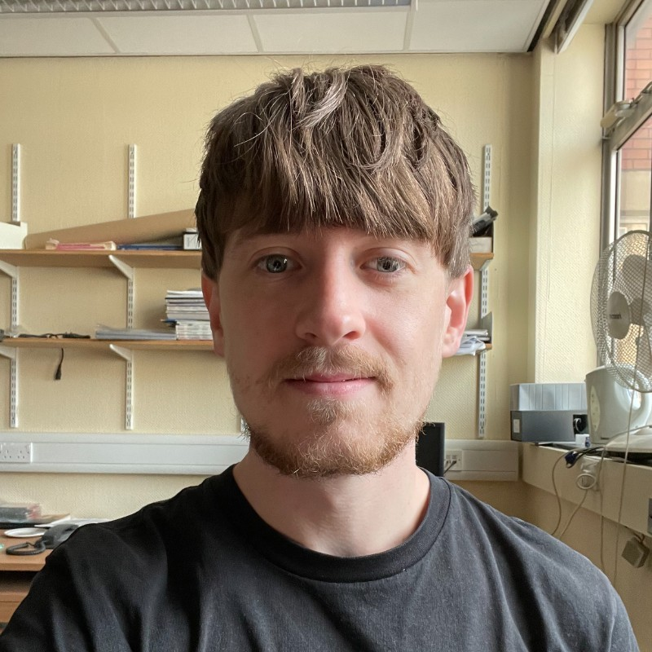
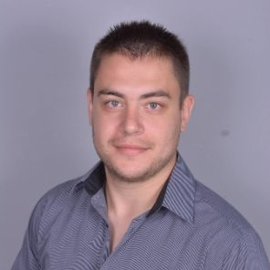
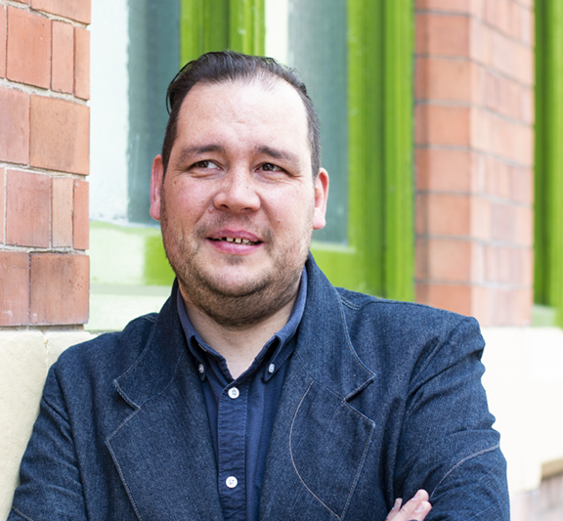
Our Team
Dr Dan Lane
Borislav Lazarov
CO-FOUNDER
CREATOR
CO-FOUNDER
CREATOR
Dr Chris Harrington
Ben Rawson
Gary Morgan
REGULATORY
LEAD
BUSINESS
SPECIALIST
WEB & BRAND
DEVELOPER

Slide 8
THE MARKET
The global clinical laboratory tests market size was estimated at $114.63 billion in 2023
>10k
£120m
Estimated verifications/validations per year (UK/Aus/US)
Annual cost of verification/validation (UK/Aus/US)
This does not include pharma, food, environmental, veterinary, CRO labs

Slide 9
Competition
OUT-OF-SIGHT
Our product
Insufficient for
mass spectrometry
EXPLORER
Vendor specific
EXPERT
Inefficient Excel workbooks
OUT-OF-LAST-CENTURY
Notes:
FinBiosoft – this is closest, doesn’t do mass spec validation very well – rigid for clinical stuff rather than other areas of industry
https://byg4lab.com/us/validation-manager/
Empower (vendor specific)
Excel sheets
Why haven’t industry done this – mass spec vendors don’t care about software, most income is service contracts and selling instruments

Slide 10
>£45k in grant funding already secured
TRACTION
We have built our team
Cloud app deployment, regulation handling, business development
We have built our product
Secured funding for development (>£45k), TRL:8
We have built our future
Have agreements with beta testing sites (NHS, academic, CRO)

Slide 11
Licensing access to software
Subscription and pay-as-you-go model
Offer a freeware version
Reduced functionality, bolt-ons available for purchase
Vendor adoption
Incorporate into existing systems
BUISNESS MODEL

Slide 12
Finances
1
2
3
Beta-test License model goes live
Refine product
User growth
International expansion
Deploy into different sectors
2025
2026
2027
Sell to 30 labs
Cheapest model £12k per year
Turnover: £240,000
Year 2 costs: £208,997
Year 2 net profit: £31,003
Sell to 10 labs
Cheapest model £12k per year
Turnover: £120,000
Year 1 costs: £85,283
Year 1 net profit: £34,717
Sell to 100 labs
Cheapest model £12k per year
Turnover: £1,200,000
Year 3 costs: £749,498
Year 3 net profit: £450,502

Slide 13
SUMMARY AND CALL TO ACTION
Mission
Our mission to transform lab validation, saving them time and money
Call to action
We need to raise £85,283 to enable to support market entry, product development, and expansion efforts.

Slide 14
Thank you
ValidateLabs Validation Processor
Dr Dan Lane & Borislav Lazarov

