Slide 1
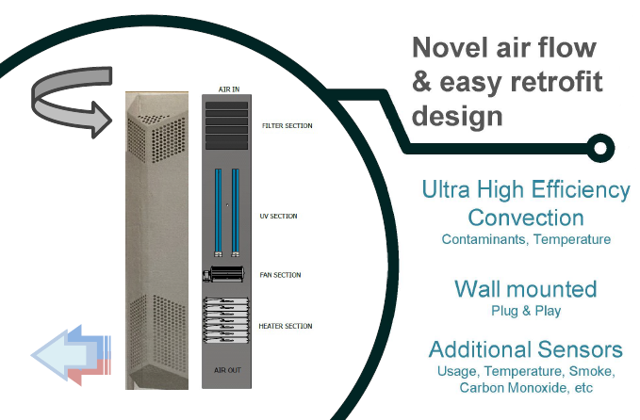
EnHANCE Combi system:
Ceiling -to -Floor air handling and warming
a patent filed technology
applying concepts in air handling/treatment and some unique thermal engineering (ref: GB2406059.2)
suitable for residential, office, warehouses and agricultural settings
Dr Abhisek Tiwary (DMU)
Mr Richard little (jenton Internlational ltd.)

Slide 2
Problem
The UK has some of the highest prevalence of allergic conditions in the world, which is rising by about 5% every year - costs the NHS around £900 million each year, mostly through prescriptions
There is an increasing ageing population in the Western world and post COVID-19 healthy indoor living globally has created greater demand for affordable solution to climate-controlled germ-free indoor space
UK households require indoor warming for 50% of year (average) to make them livable (vulnerable/elderly group much frequently)
All the above has led to a business need to develop an optimised, production-ready and market-acceptable integrated air-handling unit, capable of regulating both air quality and temperature in indoor space
Notes:
What’s the problem you’re targeting ? Without a
problem to fix, it is much harder to explain why your customers will buy. Can you back it up with data?
The UK has some of the highest prevalence of allergic conditions in the world - 44% of adults and 50% of children in the UK have one or more allergies. The number of people with allergies is rising by about 5% every year. Allergies cost the NHS around £900 million each year, mostly through prescriptions
as well as require
indoor warming for 50% of year (average) to make them livable (vulnerable/elderly group much frequently).
There is a business need to develop an optimised, production-ready and market-acceptable integrated air-handling unit, capable of regulating both air quality and temperature.

Slide 3
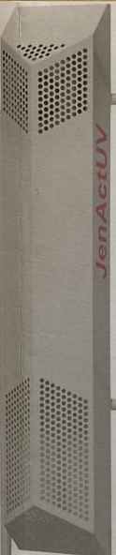
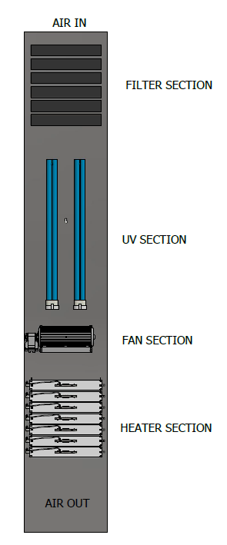
Our Solution
Performance Advantages
Unique Technology Combination
Unique Circulation Optimisation
Ceiling In – Floor Out
Advanced Air Filter Array
Pre – HEPA – Carbon
Maximises Aerosol Capture
99.99% Purification
Multibarrel UV Chamber
On Demand, Energy Efficient
In room control
Low Noise, Efficient Fan
Ergonomic Design
Clean finish &maintenance
Efficient Heating Elements
Fast, Low Cost Operation
Comfort Cooling Unit

Slide 4
Solution
Our system addresses both these aspects:
  Removes multiple biological/chemical indoor air pollutants with up to 100% efficiency
  Provides an automated climate control system (heating/cooling) with over 15% energy efficiency and over 50% cost savings compared to commercial Aircon systems (Daikin Air Conditioning RXM20R)
The greatest benefits to be achieved for the elderly independent living homes, care homes and council housing estates (where our solution can help reduce infection, a critical failure during the COVID-19 pandemic)
Notes:
• A multi-functional device that provides both air purification and heating, promoting a healthier and more comfortable environment.

Slide 5
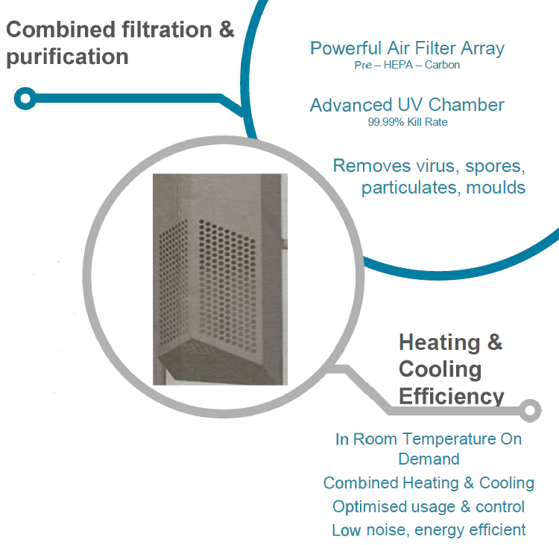
Product
A combi ceiling-to-floor indoor air handling and warming unit, supporting current UK strategic priority areas – Clean Air Programme (CAP), Net zero fossil free heating, Smart Independent Living
Continuous heat extraction, with the water bath control unit for regulating temperature to release cooler air over summer
Notes:
Our USP
combi ceiling-to-floor indoor air handling and warming unit, supporting current UK strategic priority areas – Clean Air Programme (CAP), Net zero fossil free heating, Smart Independent Living
continuous heat extraction, with the water bath control unit for regulating temperature to release cooler air over summer

Slide 6
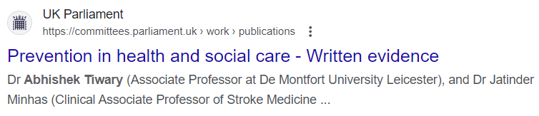
Why Now:
Net zero policies leading to alteration in building standards for ventilation and space heating methods are expected to influence future indoor air quality (source: Effects of net zero policies and climate change on air quality The Royal Society, 2021)
Key policy drive – Government needs to adopt a fresh perspective on ensuring the role of technology in facilitating healthy independent living for older people, both towards maintaining their healthy living space under normal conditions
Inquiry Proposal to the Prevention in health and social care committee (PHS0556), Published 16 March 2023 -

Slide 7
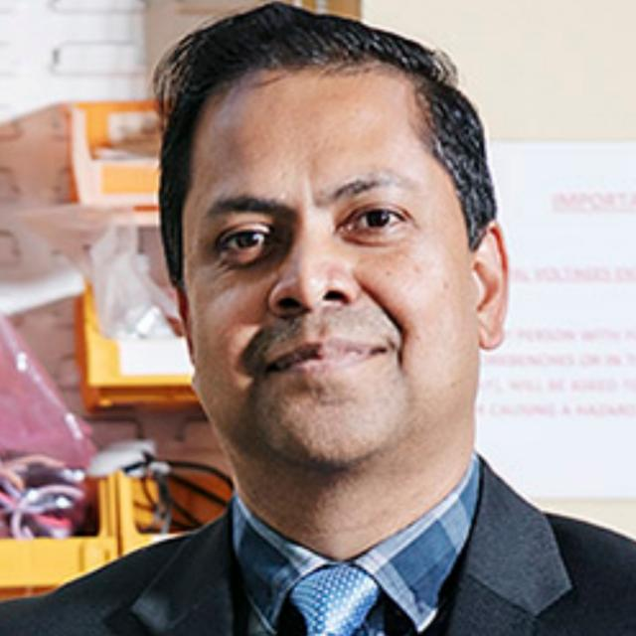
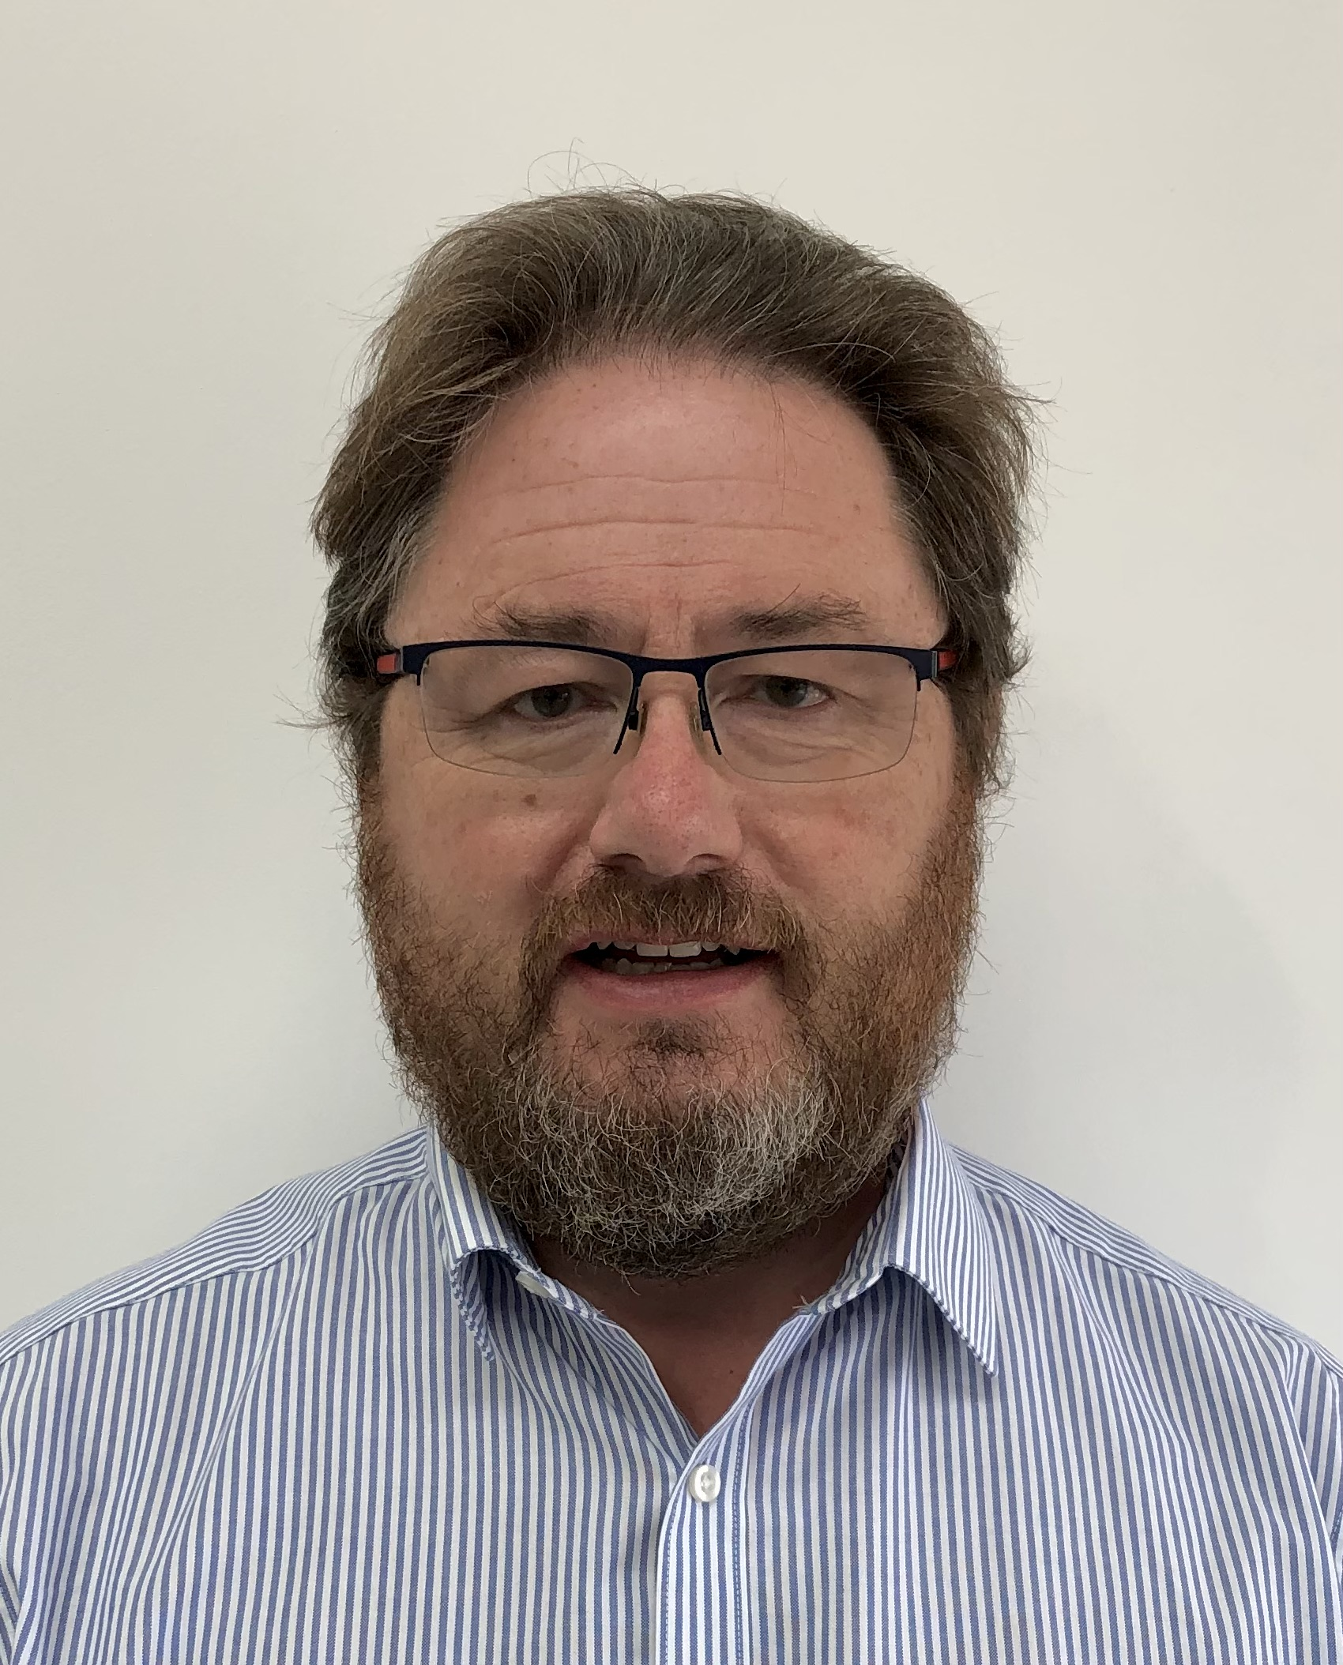

The Team
Dr Abhishek Tiwary@De Montfort University – Academic innovator
Associate Professor and RAEng Industry Fellow (https://www.enhanceprojects.info/)
Mr Richard Little@Jenton International – Industry collaborator
specialises in UV disinfection and sanitization solutions (> 20 yrs experience)
Peter Row (expertise in advanced engineering pollution control systems)
supported by Gareth Davies (product design manager)
Ms Anjuu Trevedi, Technology Transfer Officer @De Montfort University
Head of Knowledge Exchange and Innovation, Enterprise and Business Services
Notes:
Make sure your audience know why you and your team are uniquely suited to take this IP/idea forward. What is it about you as a team that means you can be trusted to receive and deploy the grant to generate the outcomes you anticipate delivering by the end of the commercial accelerator?

Slide 8
The Market
Primary market is UK clients with a duty of care
  Residential: elderly independent living, care homes, social housing
  Commercial/Public: dentists/surgeries, nurseries, schools, etc.
£240 M
TAM
Total Addressable Market
c200,000 residential + commercial properties, installing 1 unit at price point £1200/unit
£7.2 M
SAM
Service Addressable Market
c200,000 residential + commercial properties with 3% market penetration, installing 1 unit at price point £1200/unit
£2.4 M
SOM
Serviceable Obtainable market
c200,000 residential + commercial properties with 1% market penetration, installing 1 unit at price point £1200/unit
GO TO MARKET!

Slide 9
Competition
Cooling/ Heating
Energy demand
Mechanical Ventilation Heat Recovery (MVHR) units/ Air handling device manufacturers (e.g. Vent-Axia)
Commercial Aircon systems (Daikin Air Conditioning RXM
Air Purifying
Portable systems (e.g. Dyson Air Purifier fan - HP series)
EnHANCE Combi system
Cost
Notes:
Competitors – none so far, in the spec of offering combo air cleaning and climate control features
MVHR units/ Air handling device manufacturers
Immersion Cooler accessory cooling system developers using water bath and heat exchanger technique (e.g. Thomas Scientific)
This is competition from other businesses, processes or
regulation. Your IP/idea may just not have a market or be excluded from that market. These needs to be appropriate for the stage of the business.

Slide 10
Business Model
Stage 1: Customer discovery and Validations (TRL 6-7)
Yr 0-1
Stage 2: Direct Product Sales to build client base (TRL 7-8)
Yr 1-3
Stage 3: Licensing for mass manufacture from an expanding system install base (TRL 7-8)
Yr 3-5
Stage 4: B2B Maintenance contracts to support multi-site customers (TRL 9)
Notes:
This is where the company explains the revenue model
and how that works (there could be more than one way to create
revenue).Is it a licensing, business-to business, subscriptions, etc.

Slide 11
Finances
 | Yr 1 | Yr 3 | Yr 5
Sales | 50 units @£1200/unit | 1000 units @£1000/unit + Consumables sale | 5000 units @£1000/unit + License fee
Profit | £35,000 from unit sale (£700/unit) | £700,000 from unit sale (£700/unit) + £70,000 from Consumables | £3.5M from unit sale (£700/unit) + £100,000 from Consumables + £250,000 from licensing
Notes:
Provide a three-year financial summary - headline figures for sales and profit to help demonstrate the market potential.
building to say 1% [or 3% for example], and an average of 2 units per site, that would yield demand for 14,000 [42,000] units annually. At an £800/unit nominal cost that gives annual revenues of £11.2m [£33.6m].
• Sales
Year 1 14,000 units @£800ea
[rising to Year 5 17,000 units]
• Equipment Profit
Year 1 £480/unit yields £6.7m Profits
[rising to Year 5 £540/unit yields £9.1m]
• Consumables Profit (workings shown elsewhere)
Year 1 £70k and 1% of profits
[rising to Year 5 £388k and 4% of profits]

Slide 12






Next steps
Notes:
Route(s) to market envisaged
Airgard/Signify-Philips will be engaging (pitch/showcasing) with independent retired homes/care homes clients & managers of sheltered houses, neighbourhood councils, dental/surgery associations
Preliminary discussions with potential licensing options – Home-Fresh®,, Philips, Bosch
Jenton liaising with policymakers, alongside leveraging publicity (web, twitter)
..
LCC – Public Health Department

Slide 13


Invitation
Notes:
Route(s) to market envisaged
Airgard/Signify-Philips will be engaging (pitch/showcasing) with independent retired homes/care homes clients & managers of sheltered houses, neighbourhood councils, dental/surgery associations
Preliminary discussions with potential licensing options – Home-Fresh®,, Philips, Bosch
Jenton liaising with policymakers, alongside leveraging publicity (web, twitter)
..
LCC – Public Health Department

Slide 14

Thank you
Contact: Abhishek Tiwary
abhishek.Tiwary@dmu.ac.uk
https://www.enhanceprojects.co.uk/projects
Acknowledgements:
Notes:
These will provide strong testimonials and use case scenarios to promote - expand the proposition into other high value-controlled building environments such as factories, animal husbandry or food production.

